Slide 1
Application Security Assignment 2 Presentation
August Tan
Piyush Jadhav

Slide 2
HayStack.IM

Slide 3
Architecture
Haystack is based on Microservices architecture.
The application is decomposed into individual services, and deployed separately from one another on separate hosts.
Each microservice is aligned with a specific business function, and only defines the operations necessary to that business function.
These microservices are run on containers in Docker.
These Docker Containers are deployed on Amazon Web Services EC2 instances.
Uses discovery service. When a new service instance is created, the rest of the network can automatically find it and start to communication with it.

Slide 4
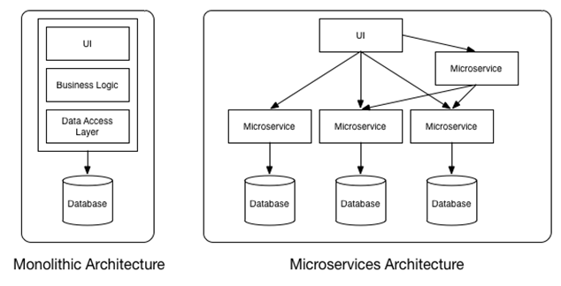

Slide 5
Security Concerns Unauthorised Access to Services
Every call to each service should be authenticated. Many systems have an authentication gateway that authenticates the initial API call. The Internal calls are not authenticated. Thus if anyone has access to the network, they can access any service inside including the one that contains the sensitive data.
There should be a secure way for the services to authenticate each other. One way to do that is to user SSL certificates for authentication
The Services should always pass the identity of person who originated each call while making calls to internal services. Even if the information is not directly required by the service. This ensures all calls in the systems are accounted for.

Slide 6
Security Concerns Unauthorised Access to Services
Services should NOT let their callers access all the APIs that a service offers. They should provide access to just the ones it needs to fulfil its function.
If an attacker owned a service, there should be some mechanism to stop them from requesting anything from its downstream services.
The request received, should be checked for tampering.
Services should be protected from replay attacks. HTTPS and TLS/SSL can be used to protect against replay attack.

Slide 7
Security Concerns Messaging Middleware Security
The application may use a messaging middleware like apache Kafka for asynchronous messaging between the services.
Attacker who gets hold of one of the services messaging credentials should be limited access to sensitive data.

Slide 8
Security Concerns Password Security
Keep up to speed with the state of the art in password storage
Using just salted password is not enough these days. The attackers, with today’s hardware can calculate ridiculously high number of hashes quickly. Below are the numbers that demonstrate how many hashes can be generated in a second on a 25-GPU rig.
Scheme | Tries/sec
NTLM | 350,000,000,000
MD5 | 180,000,000,000
SHA1 | 63,000,000,000
SHA512Crypt | 364,000
Bcrypt | 71,000

Slide 9
Service Discovery Security
Is the connection information into a globally accessible location?
Are the connections encrypted with SSL/TLS. ? satisfactory. However, most applications would probably benefit from additional security.
There are a number of different ways to address this issue. One solution is to continue to allow open access to the discovery platform itself, but to encrypt the data written to it. The application consumer must have the associated key to decrypt the data it finds in the store. Other parties will not be able to access the unencrypted data.
For a different approach, some service discovery tools implement access control lists in order to divide the key space into separate zones. They can then designate ownership or access to areas based on the access requirements defined by a specific key space. This establishes an easy way of providing information for certain parties while keeping it private from others. Each component can be configured to only have access to the information it explicitly needs.

Slide 10
Therefore it advised that you use modern techniques like scrypt ,bcrypt or PBKDF2
When a password is entered wrong, what feedback do you give? Is there a difference in response time if the user does not exist in the database? This could be used for username enumeration.

Slide 11
Database Checks
Each Service has its own database. This can be a major security issue, because then you don't even have a centralized way to determine if bad things are happening.
It creates a lot of issues around where you would go for a single source of truth for validating compliance, or validating any type of check or rule that you're trying to implement for security control.

Slide 12
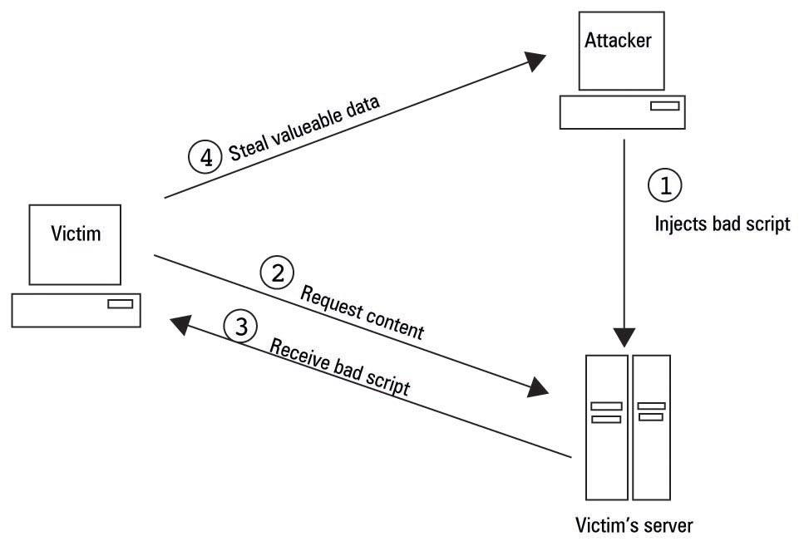
Script Insertion Attacks

Slide 13
LSQ.IO

Slide 14
Intoduction
Microservices has become an emerging architecture that many companies have evolved from using in place of a monolithic architecture. Big names like Netflix, Ebay, and Amazon have begun using it.
One of the drawback with this system is the amount of complexity that is necessary to code in that environment. Another drawback is the amount of memory consumption that is required for running the multiple microservices.
The purpose of LSQ is to remedy these problems by making it PaaS to manage all your microservices. However, with this new service, comes many security concerns?

Slide 15
LSQ is developing a platform and developing environment for microservices and as such, they should give their clients an architecture that is easy to code in while minimizing security risks.
One of the main issues with this microservice framework would be an attacker posing as a client. This attacker could then initiate an internal DDos attack. They could abuse LSQ’s cloud infrastructure by spawning a large amount of microservices, say millions, which would then overload their servers and possibly crash them. This could be remedied by LSQ throttling the amount of containers that they allow on their cloud service per user.

Slide 16
In addition to the concerns with the infrastructure of their cloud service, LSQ should be doing their best to mitigate any causes developers may have for making vulnerable containers. Meaning, that it is LSQ’s responsibility to develop a base microservice that would ideally handle as many of the security vulnerabilities as possible. This includes things like what level of access would an attacker have if they are able to establish a connection to a microservice.
Is it just that single microservice that is compromised or can the attacker then use that microservice to communicate false information to other microservices? To remedy these issues, LSQ should only allow a microservice to be used if it is called or pinged by another microservice. That way a compromised microservice container cannot mess with other containers by transmitting them faulty http requests. For LSQ, it is important for them provide a base platform that manages security for its users as well as keep their cloud service secure.

Slide 17
Project Economics

Slide 18
Introduction
Project economics is a behind the meter origination platform that allows stakeholders to manage project life-cycles and their repayment terms electronically.
The startup gives companies, specifically energy and utility companies, a tool to manage their finances and schedule their workflow accordingly.
What this means security-wise is that the startup has to manage sensitive user data such as finances while giving them instances of their platform to work with.

Slide 19
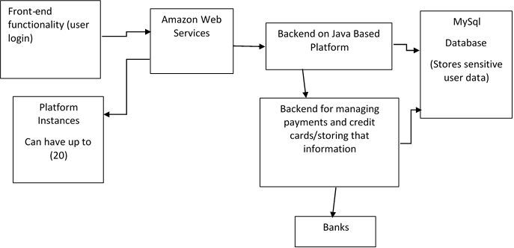
Architecture

Slide 20
Valuable Assets
Customer Data (Sensitive Information)
Billing (ACH and Credit Card Transactions)
proprietary code/models/calculations

Slide 21
Security Concerns AWS Vulnerabilities
There is a vulnerability in AWS, that makes it possible to map the internal cloud infrastructure, identify where a particular target VM is likely to reside, and then instantiate new VMs until one is placed co-resident with the target.
Such placement can then be used to mount cross-VM side-channel attacks to extract information from a target VM on the same machine.

Slide 22
Solution ?
Use Dedicated Instances
Trade Off Between Security and Cost .

Slide 23
SQL Injection Attacks
Make Sure That all Inputs are properly sanitized

Slide 24
Questions ?

